Slide 1


Artificial Intelligence in Mechanical design
Using Machine Learning in Mechanical Design for optimization and Productivity

Slide 2



Use Cases
 | Situation | Solution | Benefit
1 | Continuous and monotonous QC check In CAD Drafts to check the Accuracy which usually has Errors? | A tool that can check the CAD Drafts intelligently using Machine Learning and always gives accurate results without any use of Manpower. | Improve Quality and Savings
2 | How much budget I need to complete an upcoming release? What are my options to contain cost with out compromising quality ? | A tool that can intelligently predict budget, schedule, effort etc. to help the management in decision making | Increase Effectiveness, Increase In Savings
An innovative analytics driven engine leveraging intelligent robotic automation technologies such as Machine Learning, Text Analytics and Natural Language Processing

Slide 3
AI Powered QC Automation
Why AI?
Computer are fundamentally well suited for performing mechanical computations ,using fixed programing rules. This allows artificial machines to perform simple monotonous task efficiently and reliably ,which humans are ill suited to.
Limitations of Humans in QC
Object recognition :- Usually people cannot properly explain how they recognize different objects in a CAD Model.
Error Recognition:-Sometimes error are left unidentified because of fatigue and lack of concentration.
Time consuming:-Any task performed is time and effort consuming by humans.

Slide 4
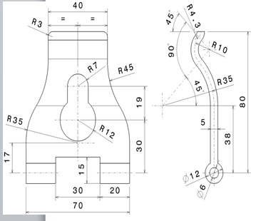
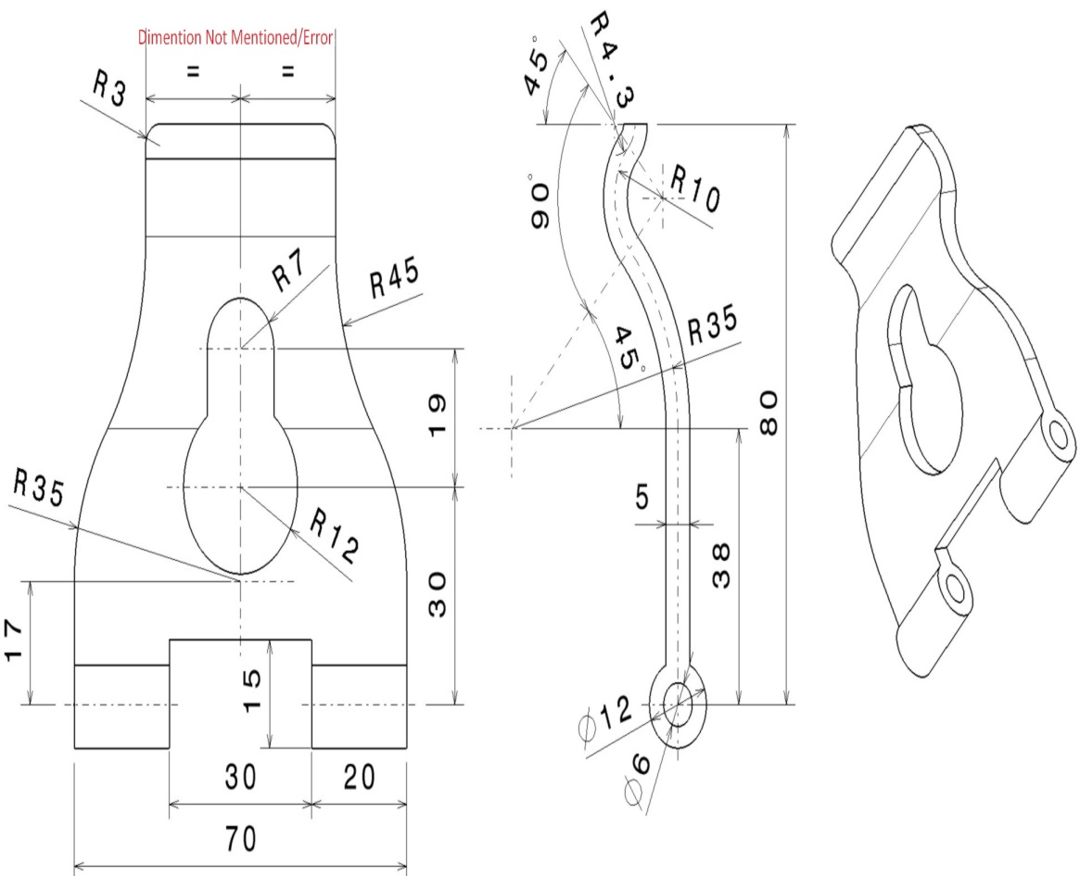
QC CAD Automation Using AI
Automating the process of QC Check with the help of Machine Learning.
Checking the Actual 2D drawing and the Final Draft model using OCR (Optical Character Recognition ) and Natural Language Processing (NLP) for the errors and Missing Information .

Slide 5

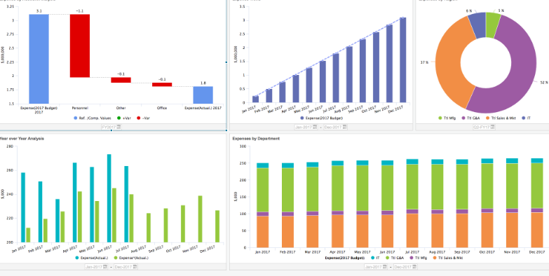
Adaptive Planning
User can predict parameters related to the program management providing the historic data of the previous executed projects ,using Machine Learning Algorithms.
Example of the parameters which can be predicted are:-
1)Adaptive Budget
2)Project Status
3)Resources Needed , etc.

Slide 6
Advantages and Benefits
Maximum productivity with minimum error rates.
Helps in Planning and execution of the project.
Lot of time and effort are saved.
Leading the field of QC compared to peers by using the most advanced technology.
Customer satisfaction because of the reduction of errors and expences.

